Slide 1
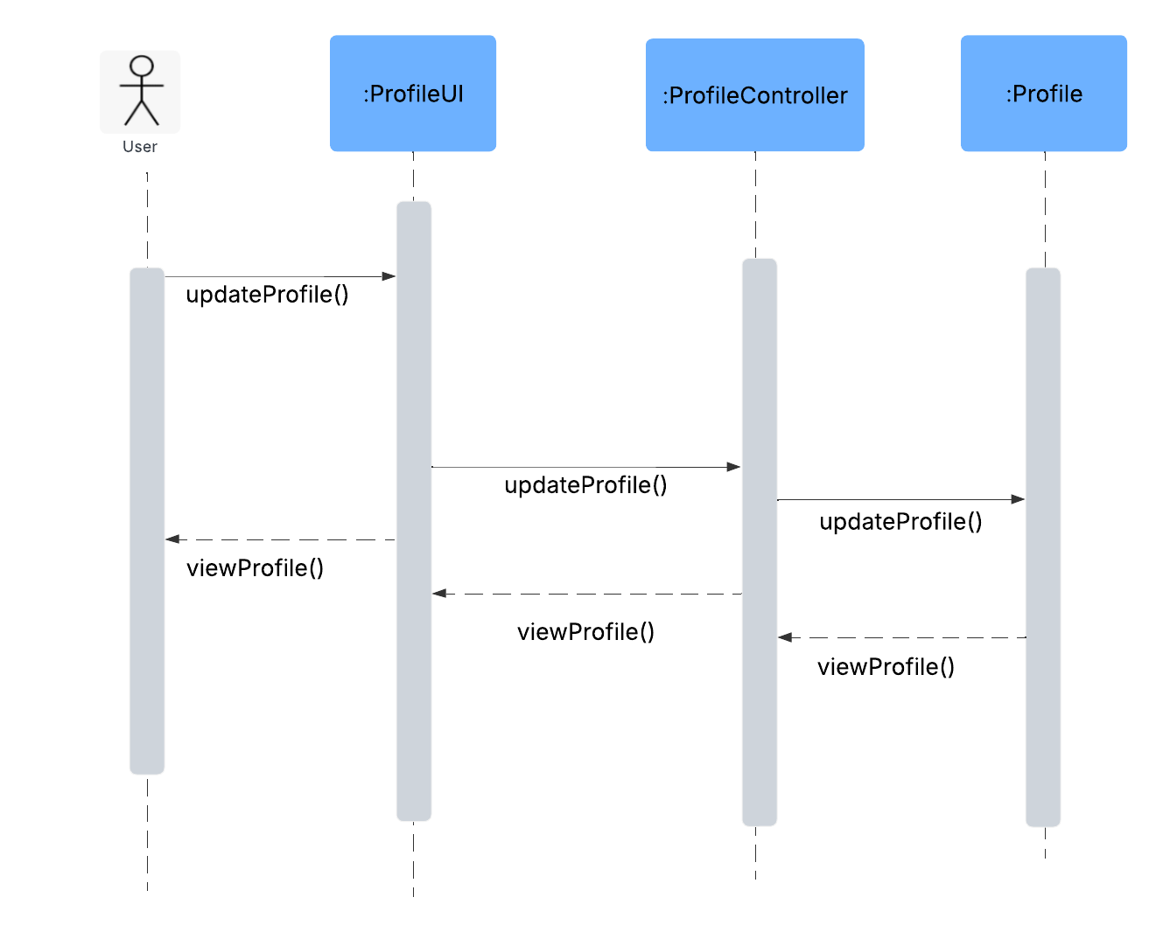
Heart and Paws Sequence Diagram - Team 4
User Story : 01.05 Edit Profile
User Story Outline: 1. This use case begins when the Actor (logged-in user) chooses to edit their profile. 2. System displays the current profile details (name, email, image). 3. Actor makes desired changes and submits the form. 4. System validates and updates the profile in the database. 5. System confirms update and displays the updated profile.

Slide 2
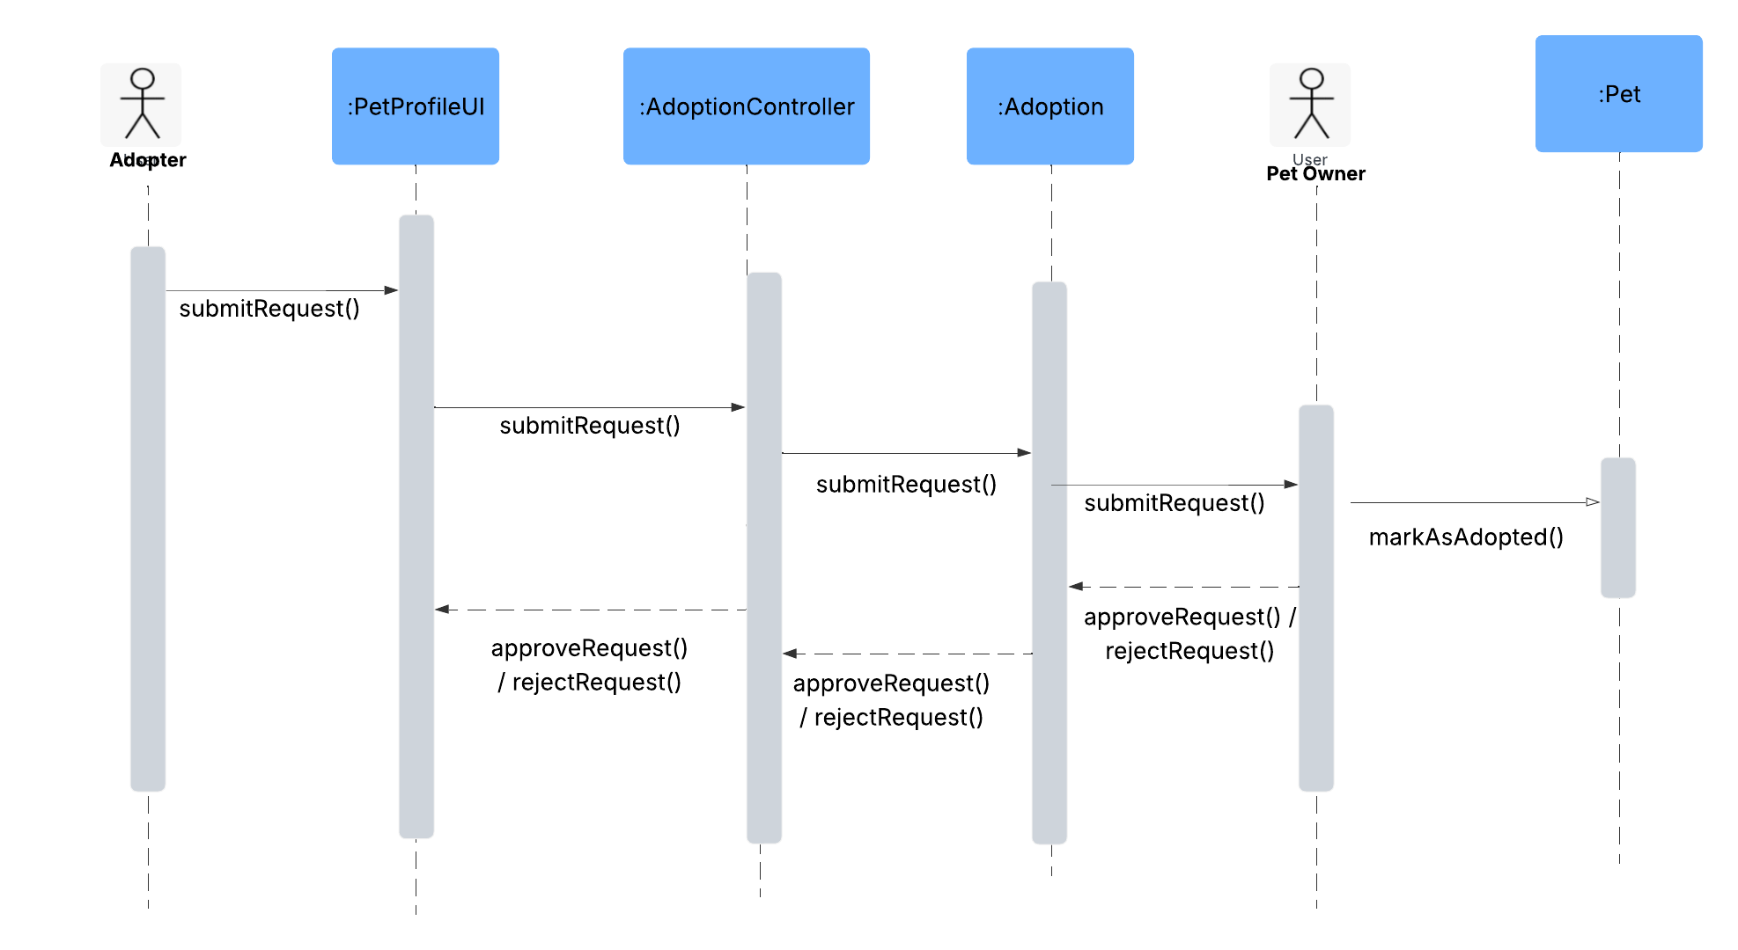
Heart and Paws Sequence Diagram - Team 4
User Story : 03.04 View Adoption Requests
User Story Outline: 1. Adopter submits an adoption request using submitRequest(). 2. The request flows from PetProfileUI to AdoptionController and then to Adoption class. 3. Pet Owner views and either approves or rejects the request using approveRequest() or rejectRequest().
4. Pet Owner also marks the pet as adopted.

